Slide 1

R.Indumathi
S.Maheshwaran
Jaishree Subramaniam
Final Year CSE
Project Guide
Mrs.J.Jayanthi B.E

Slide 2
Objective
To construct a digital circuit simulator software
Ease the construction of the digital circuits.
To provide the comfort of working in the local language.
Make available throughout the world on internet
Provide an API for extensibility
Minimize the time taken for construction and verification of digital circuits.

Slide 3
Problem Description
Construction of digital circuits are complex
Component failure during construction is a loss
Most of the digital circuit simulator softwares are platform dependent
Work with various complex digital circuits such as Sequential and Combinational circuits.
As an educational tool, it should reach every one who are to read digital circuits.
Most of the circuit simulators available are not prone to updating

Slide 4
Need for Jlogics
Ease the construction of the digital circuits.
Understand the working of digital circuits.
Minimize the time taken for construction and verification of digital circuits.
To provide the comfort of working in the local language.

Slide 5


Need for JLogics
Features | xLogicCircuits | LogicSim | Jlogics
Gates | AND,OR,NOT | AND, OR, NOT,NOR,NAND, XOR | AND,OR,NOT,NOR,NAND,XOR, Clocks, Switch, Toggle Switch
Circuit to Module Conversion
Boolean Equation to Circuit
Circuit to Image
Feature Available
Feature Not Available

Slide 6
Need for JLogics...Contd
Features | xLogicCircuits | LogicSim | Jlogics
Extensible API’s
Localization
Inputs for gates | Only 2 | 2 to 3 | Up to 32 inputs
Properties Modification

Slide 7
Architecture
IC Module
Circuit
Gates
Flip Flops
Circuit API
Additional Inbuilt Circuit Library
Circuit Simulation Engine
Persistence Storage
Graphical User Interface

Slide 8
Core Modules
DigitalShape ◄ Rectangle
  Used for: Drawing, reshaping
  Defines abstract shape of any object i.e Gate, Node etc.
DigitalObject ◄ DigitalShape
  Used for: inputs, outputs, repositioning
  Defines a digital object such as gate, module with Nodes
Gate ◄ DigitalObject
  Used for: simulation, define inputs, outputs, label, name, color, shapes
  Abstract structure of any Gate with input and output nodes

Slide 9
Core Modules...Contd
Circuit ◄ Gate
  Used for: Collection of Gates, simulation
  Defines the container for collection of Gates and IC Modules that are being drawn
MouseSensor
  Used For: Mouse Actions
  Implements operation for various mouse actions.
TruthTable
  Prepares truth table for the given circuit.

Slide 10
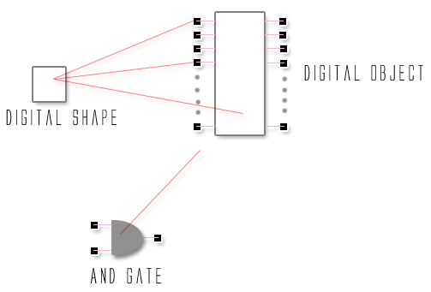
Core Modules…Contd

Slide 11
Algorithms
Simulation Algorithm ( BFS Algorithm )
  This algorithm is used in the simulation of Gates, transferring inputs and outputs, processing .
Equation to Circuit Algorithm
  This algorithm is used in the conversion of equation to circuit
Module Conversion Algorithm
  This algorithm is used to generate an IC like module from a given circuit.
Truth Table Generation Algorithm ( Exponential Algorithm )
  This algorithm is designed to generate truth table for a given circuit.
Boolean Equation Minimization Rule
  Boolean Equation minimization using prolog rules

Slide 12
Localization
Exponential increase in the non-English speaking users of software.
Being an educational tool, availability in the local language is an added advantage for the student community.
Localization is surely the next step towards Internationalization.

Slide 13
Localization
One attempt to support localization for “Tamil” is “Kaniam” by Anna University and IIT Chennai.
The advantage of using the software and its efficiency reach far and wide because of localization.
The number of people using the software also increases due to its immense user friendliness provided by localization.

Slide 14
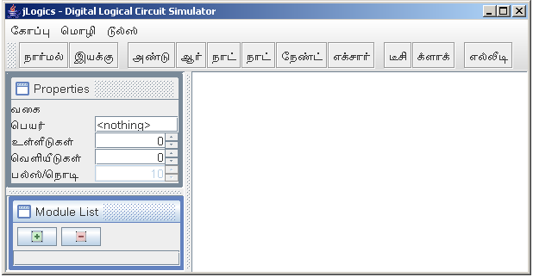
Localization – Tamil view

Slide 15
Conclusion
Jlogics is by now simple software with a large amount of inbuilt features.
Our aim was that software should be helpful to people like us who wanted a way to make things better and simple in this complex world.
Constructed Circuit API to develop more complex circuits

Slide 16
JLogics - in Future
Enhancing Circuit API to support for VLSI designs
Provision for inbuilt library circuits such
  Registers
  Counters
Timing diagram
Well built equation reduction system
Circuit verification and analysis process

Slide 17
References
Books
  Brett Mclaughlin, (2nd Edition) “Java & XML”, O’Reilly
  David M.Geary, (3rd Edition)Graphics “Java – Mastering JFC”, Sun Microsystems Press
  Godse A.P (1st Edition) “Digital Circuits”, Technical Publishers
  Hebert Schildt,(5th Edition) “Java Complete Reference” , Tata McGrawHill
Website
  http://java.sun.com/docs/books/tutorial
  http://www-106.ibm.com/developerworks/
  http://www.devx.com/
  http://www.javaworld.com
  http://kom.auc.dk/logic/
  http://java.sun.com/docs/codeconv/html/CodeConvTOC.doc.html

